Slide 1
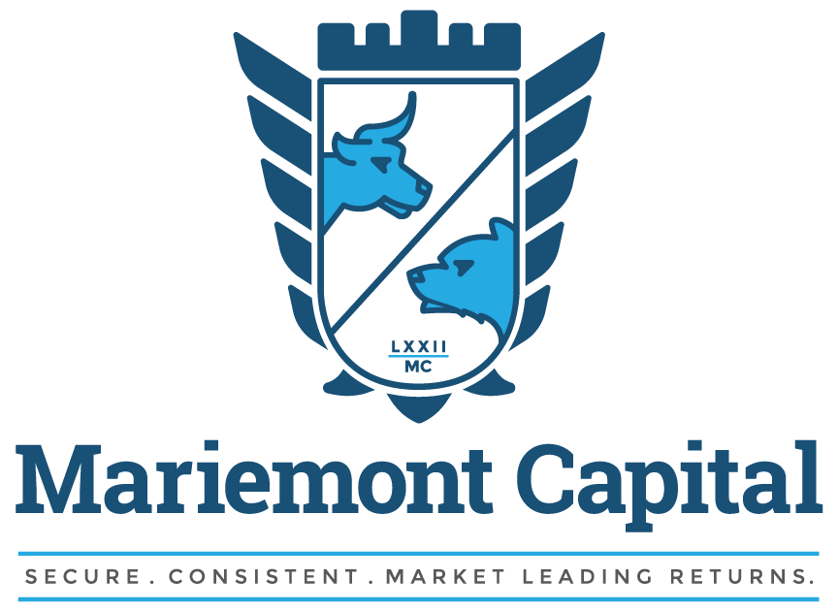
Notes:
Cover Slide

Slide 2
Fund Description
High-Yield RMBS Limited Partnership
Focus on Senior, Non-Agency, Residential Mortgage-Backed Securities (RMBS)
Seek securities with superior return potential and capital preservation characteristics
Created to capitalize on commercial banking regulation
Notes:
Standard Slide

Slide 3
Performance
 | 2014 | 2015 | 2016 | 2017 | 2018 | 2019 | 2020 | 2021 | 2022 | 2023
Mariemont Capital Partners | 14.9% | 6.8% | 9.2% | 7.9% | 2.2% | 7.4% | 2.6% | 2.5% | -6.5% | 2.1%
Bloomberg US Agg Bond Index | 5.8% | 0.6% | 2.6% | 3.5% | 0.0% | 8.7% | 6.3% | -1.5% | -13.1% | 5.5%
Mariemont Capital began investing on January 21, 2014
Performance through December 31, 2023
Notes:
Standard Slide

Slide 4
Performance Since Inception
Notes:
Standard Slide

Slide 5
Balance Sheet
Assets Under Management
Launched in January 2014 with $1 million in capital
As of December 31, 2023
$42.6MM of Assets
Significant investment from the General Partner
Our largest investors include:
Family Offices
Insurance Companies
Private Equity Company
Corporations
Investment Professionals
Notes:
Standard Slide

Slide 6
Fund Return Drivers
Seek Above-Market Returns through 3 Drivers:
Buy and Hold for the Long-Term
4.0%-5.0% annual return
Market Making Strategy
1.0%-3.0% annual return
Use of Leverage
2.0%-4.0% annual return
Designed to create annual returns of 7%-12%
Notes:
Text slide

Slide 7
Buy & Hold for the Long-Term
Non-Agency RMBS yield 5%-6% on a loss-adjusted basis
Current Portfolio LAY – 6.79%
Core Characteristics Evaluated
Current LTV
Year of origination
Prime, fixed-rate, amortizing
Weighted avg. loan age
Credit scores
Prepayment rates
Delinquency rates
Loss severity rates
Geography
Underwriters
IGNORE the ratings agencies!
Notes:
Data Slides…Fields are to replace with graphs

Slide 8
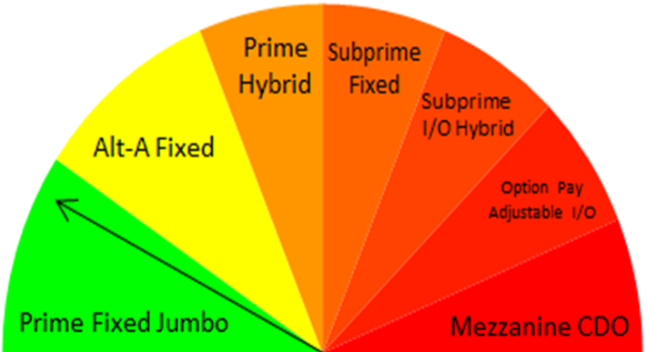
Current Loan Profile Snapshot
Key Metrics
Average Weighted 3 Month Duration – 1.98 years
Current LAY – 6.79%
Current LTV – 34.61%
Annual Default Rate – 2.96%
1 Month Severity Rate – 14.83%
12 Month Severity Rate – 31.8%
Loan Age – 206 months
Other Metrics
Loan Count – 51,740
60+ Day Delinquent – 12.8%
Fixed Rate Loans – 96.2%
Annual Voluntary Prepayment Rate – 9.32%
FICO – 710
Notes:
Text slide

Slide 9
Market Making Strategy
Market Making
Term used for supplying liquidity to market participants
Unlike stocks, there is no quoted exchange for investors to buy/sell MBS
Investors must go to a market maker to buy/sell MBS
The net effect of regulation, specifically, Dodd Frank, has reduced commercial banks ability to provide liquidity
The current market is ideal for private capital
This annual return has been significant
1%-3%
Mariemont Capital’s ability to identify correct bid levels and correct offer levels is a rare and highly profitable skill
Notes:
Standard Slide

Slide 10
Use of Leverage
Credit Facility
Non-Agency RMBS are no longer permitted to be financed through the REPO market or Margin
This annual return has been significant
2%-4%
Debt to Equity will never be more than 1 to 1
Notes:
Standard Slide

Slide 11
Interest Rate Risk
Duration
1.98 year average duration
Barclays Bond Index 6.10 years
Mitigants
Rising interest rates normally coincide with an improving economy
An improving economy should result in decreased foreclosures
Fewer foreclosures will increase our loss adjusted yields
Self-liquidating securities; the payments from the underlying loans are captured in the trust and either reinvested or used to pay down debt
Unlike callable corporate or agency debt, MBS also return principal for non-economic reasons: death, divorce, or job relocation
Notes:
Standard Slide

Slide 12
Credit Risk
Default Risk
Term used to describe the risk associated with homeowners not repaying their loan
Non-Agency RMBS does not have the guaranty of the US Gov’t, and therefore has default risk
Mitigants
Homeowners have been paying on these loans for 12+ years
Payment history is a big factor on our bid price
Current LTV of our portfolio is <35%
Lower the LTV, the less likely of a default
Average price paid per bond is $0.89/$1.00
Discounted pricing accounts for losses, so proper bid price is very important
The average coupon rate of our loans is 5.7%
We are well compensated for taking on this risk
Notes:
Standard Slide

Slide 13
Fund Structure
1.09% Annual Management Fee
Annually Audited Financials
By RSM
Monthly Investor Statement
By Strait Capital
Key Man Policy
In place for the benefit of the investors in a liquidation scenario
Kept at 3%-5% of Partnership Equity
Notes:
Standard Slide

Slide 14
Summary
The Fund Drives Returns Through:
Buying and holding for the long term
Market making strategy
Use of leverage
Outstanding Track Record
Since Inception average annual return of 4.9%
Generated positive returns in 95 of our 120 months of investing
Have beaten the Barclays Bond Index by an average of 310 bps annually
Limited Opportunity
Fund has a $250MM AUM Limit
Limit instituted to retain size necessary to take advantage of this market
Notes:
Standard Slide

Slide 15
Appendix
Notes:
Transition Slide-Use in between sections

Slide 16
Performance Since Inception
Monthly Returns | Net Positive | Net Negative | % Positive
Mariemont Capital | 95 | 25 | 79%
Bloomberg Bond Index | 64 | 56 | 53%
DoubleLine Total Return | 71 | 49 | 59%
PIMCO Total Return | 76 | 44 | 63%
Barclays US Corp HY Total Return | 76 | 44 | 63%
Mariemont Capital Partners seeks to maximize absolute return by investing in non-agency RMBS, corporate bonds, and money markets.
Bloomberg Bond Index is a market capitalization-weighted index that is designed to measure the performance of the U.C. investment grade bond market with maturities of more than one year.
DoubleLine Total Return seeks return by investing in residential and commercial MBS
PIMCO Total Return seeks maximum total return by investing in a portfolio of investment-grade fixed-income instruments
Barclays US Corp Total Return Value measures the investment grade, fixed rate, taxable corporate bond market
Barclays US Corp HY Bond Index measures high-yield, fixed-rate corporate bond market with middle rating of BB+ or below
16
Notes:
Standard Slide

Slide 17
Management
Kevin Taylor
Founder and Chief Investment Officer
26 years of fixed income trading experience
5 years trading at Wells Fargo
11 years managing Fifth Third Securities MBS trading desk
10 years running Mariemont Capital
Successfully navigated the MBS market during the credit crisis
Graduated from St. Lawrence University
B.A. in Economics
Notes:
Standard Slide

Slide 18
Supporting Partners
RSM
Provides Annually Audited Financials
The firm has 9,000+ employees across 86 cities
Located in Chicago, IL
Dinsmore Compliance Services
Kevin Woodard, Chief Compliance Officer
The firm has 650+ attorneys across 21 cities
Located in Cincinnati, OH
Strait Capital
Third Party Fund Administrator
$8 Billion in Assets Under Administration
Located in Dallas, TX
Notes:
Standard Slide

Slide 19
The Rest of the Team
Bill Kielczewski
Chief Marketing Officer
Robin Fenberg
Controller
Joseph Bauer
Analyst
Justin Taylor
Analyst
Notes:
Standard Slide

Slide 20
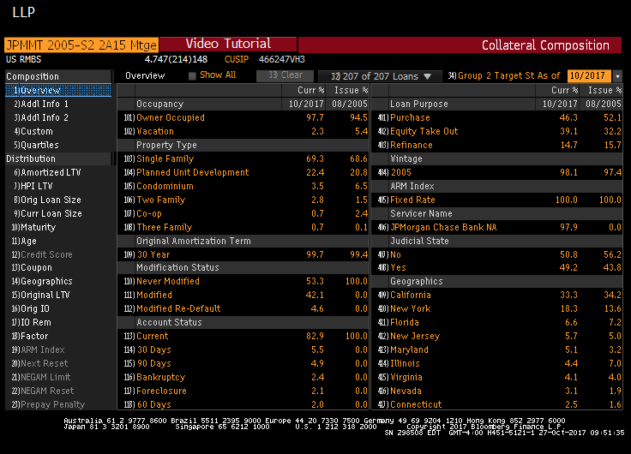
Collateral Composition
Notes:
Standard Slide

Slide 21
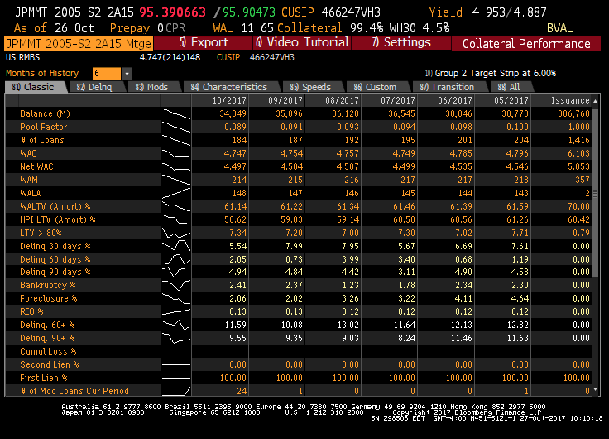
Collateral Performance
Notes:
Standard Slide

Slide 22
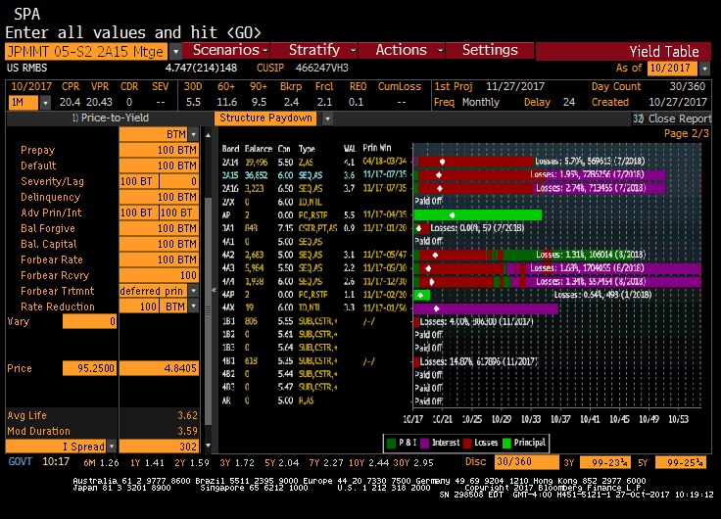
Collateral Projection
Notes:
Standard Slide

